Slide 1
Minimum Spanning Trees

Slide 2
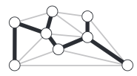
Spanning Tree
Recall that a spanning tree of a graph is a connected subgraph with no cycles that includes all the vertices.

Slide 3
Upper bound on number of MST
Let G be a complete graph on V vertices. We want to count the number of possible spanning trees where we chose one edge at each step in forming the MST
Start at vertex v₀ then vertices v₁ , v₂ , …, v_{V-1} are adjacent to it. So we must choose one of V - 1 vertices to form first edge. Use V for |V|.
After the first edge (2 vertices) is chosen, there are 2(V − 2) possible edges.
After the second edge (3 vertices) is chosen, there are 3(V − 3) edges.
… _{|V|-1}
Total possible choices = ∑ k (V − k) = (V³ − V)/6 is O(V³) ^{k=1}

Slide 4
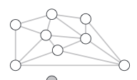
Minimal Spanning Tree
A minimum spanning tree (MST) of an edge-weighted graph is a spanning tree whose weight (the sum of the weights of its edges) is no larger than the weight of any other spanning tree.
.32
1
.29
3
5
.28
.19
.36
.17
7
.34
2
.52
.35
.37
.16
.26
0
.40
.38
.58
4
.93
6

Slide 5
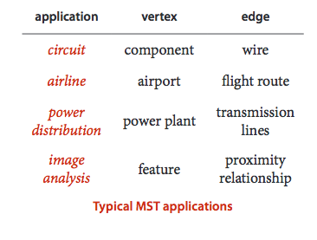
Applications

Slide 6
Edge Weighted Graphs
Similar to the Graph class
Exceptions:
Bag<Edge> adj rather than Bag<Integer> adj
edges() method provides clients with the ability of iterating through all the edges in the graph

Slide 7
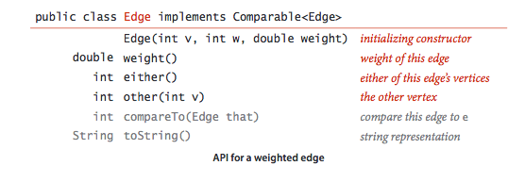
APIs

Slide 8
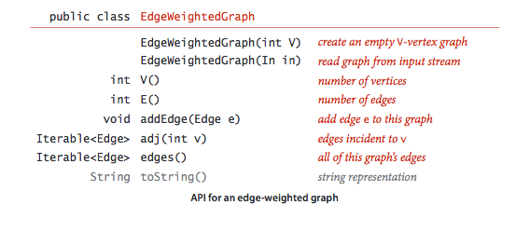
APIs

Slide 9
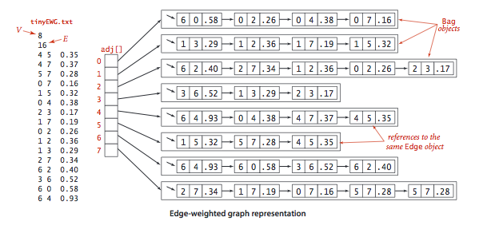
An instance of EdgeWeightedGraph

Slide 10
Lazy Prim’s Algorithm
Our first MST method, known as Prim’s algorithm, is to attach a new edge to a single growing tree at each step. Start with any vertex as a single-vertex tree; then add V-1 edges to it, always taking next (coloring black) the minimum-weight edge that connects a vertex on the tree to a vertex not yet on the tree.

Slide 11
Lazy Prim’s Algorithm
Data Structures
Vertices that are on the tree are those marked[]
Edges on the tree are those placed in the queue mst
Crossing edges (an edge joining a vertex in the tree with one not in the tree) are those placed in the min priority queue pq

Slide 12
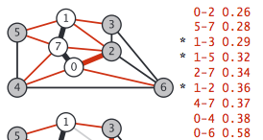
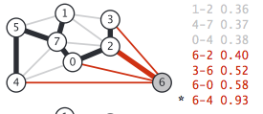
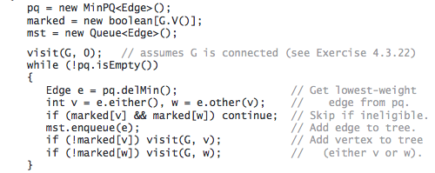
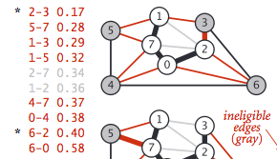
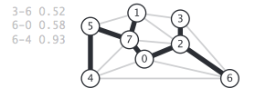

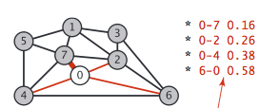
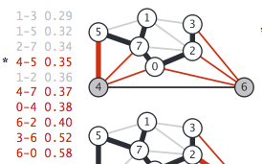
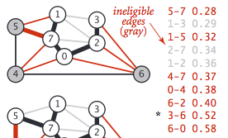
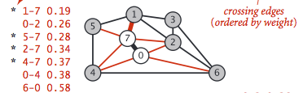

Slide 13
Analysis of Lazy Prim
There are at most E inserts into the PQ (once sent down an edge we won’t reuse edge).
At most E deleteMin() operations
The runtime is E * time to insert + E * time to delete = E log E

Slide 14

Running Time
Lazy Prim
Space E
Time E log E

Slide 15
Eager Prim’s Algorithm
To improve the LazyPrimMST, we might try to delete ineligible edges from the priority queue, so that the priority queue contains only the crossing edges between tree vertices and non-tree vertices.
But we can eliminate even more edges. In short, we do not need to keep on the priority queue all of the edges from w to tree vertices—we just need to keep track of the minimum-weight edge and check whether the addition of v to the tree necessitates that we update that minimum (because of an edge v-w that has lower weight), which we can do as we process each edge in v’s adjacency list. In other words, we maintain on the priority queue just one edge for each non-tree vertex w: the shortest edge that connects it to the tree. Any longer edge connecting w to the tree will become ineligible at some point, so there is no need to keep it on the priority queue.

Slide 16
Eager Prim’s Algorithm
Data Structures
The marked[] and mst are replaced with the edgeTo[] and distTo[] arrays
If v is not on the tree but has at least one edge connecting it to the tree then edgeTo[v] is the shortest edge connecting v to the tree and distTo[v] is the weight of that edge
All such vertices v are maintained on an indexed-priority queue where v is the index

Slide 17
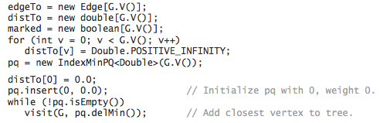
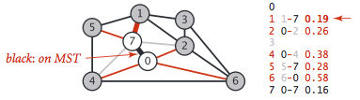
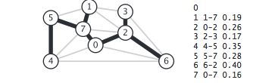
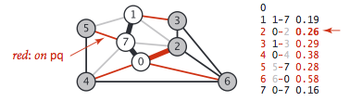
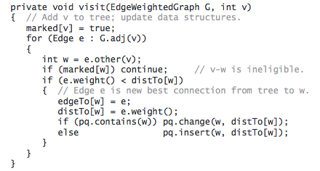
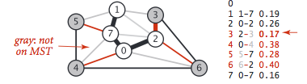
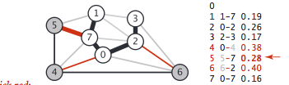
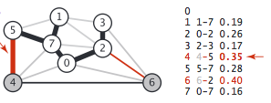
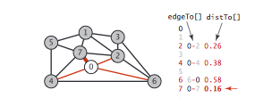
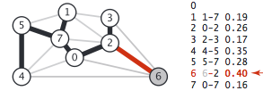

Slide 18

Running Time
Eager Prim
Space V
Time E log V

